Slide 1
Telemetry 2.0 : Guiding principles
Battery Life
Data Size
Frequency
Analysis
(Device vs Backend)
De-Duplication
(Device vs Backend)
Plug & Play
Configurability
Testable
Event based Incremental collection

Slide 2
Telemetry 2.0 : What’s new ?
OEM
Apps
ATT
Samsung
LG
Japan
Third party app
Telemetry Library
Home
Plug & play
Easy to integrate : 4 line of code to integrate.
APIs
Well defined API for any third party app developer for integration.
Can be integrated easily with OEMs, Asurion apps & third party applications.
Using Java Docs.
Documented
Documentation generated at build time.
Completely redesigned telemetry code
Reduced complexity and easy to maintain
Removed unnecessary code.
Report scheduling simplified.
Modularized into 3 main pieces : Collection, Creation and Dispatching
Easy to add new reports
Easy to add new telemetry server endpoint.
Added retry logic : Immediate or exponential

Slide 3
Telemetry 2.0 : What’s new ?
OEM
Apps
ATT
Samsung
LG
Japan
Third party app
Telemetry Library
Home
230 KB
Small footprint
Easily testable
Unit test cases
Test app to test the library
New Reports
Bluetooth
Wifi vs Network data usage
Optimizations
Event based, incremental data collection and dispatch
De-duplication of data
Battery optimized telemetry dispatch
Easy on Big Data processing
Android M support

Slide 4
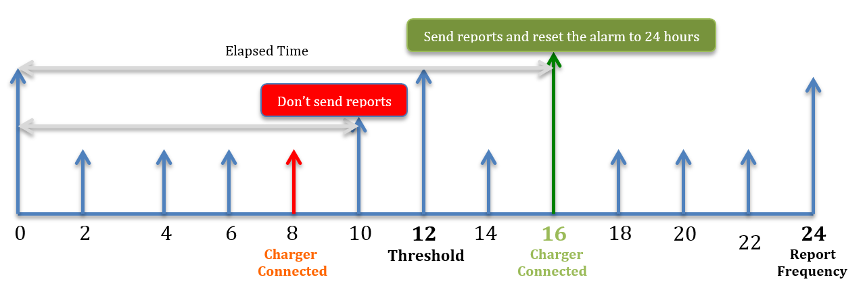
Optimizations :
Reduced Data Transfer : Event based incremental data collection
Bluetooth report
Crash reports
App Start Report
App usage report
Apps report : ( 135 KB to 8 KB)
Event based incremental data collection
De-duplication by parsing
Data point collection based on frequency segregation. ( In progress )
Daily report : X data points
3 day report : X + Y data points
Weekly : X + Y + Z data points
Monthly : X + Y + Z + A data points.
Easy on Big data processing
Make, model & OS version added to most reports.
App Start report
Android M support
Battery Usage report
Batching
Dispatch 1 MB at a time
Crash report : App name & app version added
App start Report :
Package name & time of launch added
Support to collect as often as we want
Storage report
Support for TotalPictures, TotalVideos and TotalMusic size
Battery optimized Telemetry dispatch (in progress )
In an ideal case scenario data will always be sent when device is charging.

Slide 5
Telemetry Architecture
Dispatches reports back to the app
Creates and dispatches report
Manages Telemetry service
Creates reports
Saves reports in the file system
Collects reports
Dispatches reports
Sprint
ATT
Verizon
Japan
Telstra
Home
..
..
Application
Provides Telemetry config. contract
Provides Report config. contract
Telemetry Engine
Stores configuration
Manages configuration
CLOUD

Slide 6
Android Telemetry Plan
Start : Integration with Sprint
Telstra & Sprint release to QA
Telstra & Sprint release to production
ATT, Verizon, Japan releases
Timeline
6/30
3/21
Create a Branch
Remove old library
Integrate new library
4/30
7/30
8/30
Pluggable library
(completed)
Dependency : TAP to AWS migration
Start : Integration for other carriers
Ongoing optimizations
Phase 1
Phase 2
Backlog items : Plenty
Remove duplication wherever possible
Event based collection wherever possible
Report dispatch based on needed frequency of the data points
…….
Parameter level dynamic configuration
AVRO
………

Slide 7
Plug and Play : 4 lines of code for integration.
Step 1 : Initializes an instance of the telemetry library.
Telemetry.getInstance(context).initialize();
Step 2 : Set dispatch URL (AWS \ Tap \ Azure)
telemetryConfiguration.dispatchUrl = <URL>;
Telemetry.getInstance(context).setTelemetryConfiguration(telemetryConfiguration)
Step 3 : Set Telemetry configuration
Telemetry.getInstance(context).createAndDispatchReports();
Step 4 : Call API to create and dispatch reports

Slide 8
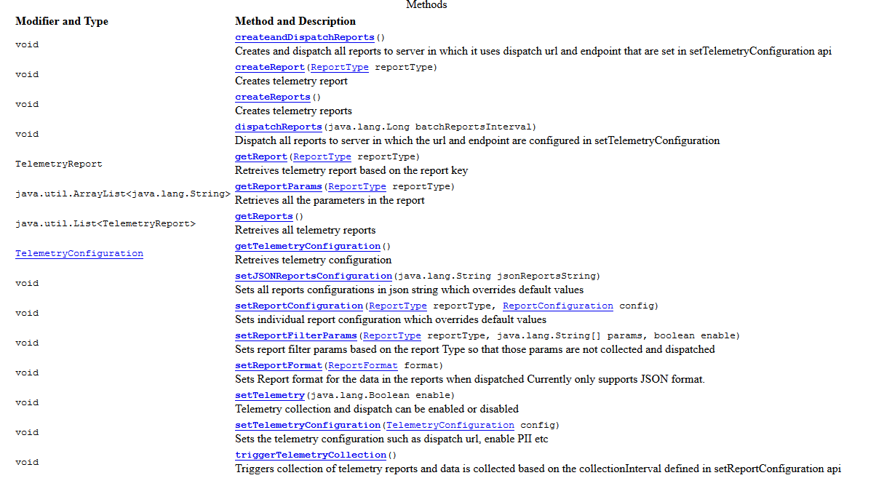
APIs

Slide 9
Reports : Per carrier
 | Collection Interval | Dispatch Interval | ATT | Verizon | Japan | Sprint | Soluto
Overview report | 8 Hrs | 8 Hrs | ✓ | ✓ | ✓ | ✓ | ✓
Settings report | 8 Hrs | 8 Hrs | ✓ | ✓ | ✓ | ✓ | ✓
Bluetooth report | Event Based | 8 Hrs | ✓ | ✓ | ✓ | ✓ | ✓
Wifi report | 8 Hrs | 8 Hrs | ✓ | ✓ | ✓ | ✓ | ✓
App report | 8 Hrs | 8 Hrs | ✓ | ✓ | ✓ | ✓ | ✓
Crash report | Event Based | 8 Hrs | ✓ | ✓ | Needs Preload | Needs Preload | Needs Preload
App start report | Event Based | 8 Hrs | Android L and below | Android L and below | Needs Preload | Needs Preload | Needs Preload
data usage report | 8 Hrs | 8 Hrs | ✓ | ✓ | ✓ | ✓ | ✓
Network usage report | Event Based | 8 Hrs | ✓ | ✓ | ✓ | ✓ | ✓
battery status | 15 min | 8 Hrs | ✓ | ✓ | ✓ | ✓ | ✓
Battery usage | 8 hrs | 8 Hrs | ✓ | ✓ | ✓ | ✓ | ✓
Storage report | 8 hrs | 8 Hrs | ✓ | ✓ | ✓ | ✓ | ✓
Application usage report | Event Based | 8 Hrs | ✓ | ✓ | Needs Preload | Needs Preload | Needs Preload
Age report | 8 hrs | 8 Hrs | ✓ | ✓ | ✓ | ✓ | ✓
Accelerometer report | Event Based | 8 Hrs | In progress | In progress | In progress | In progress | In progress

